Slide 1
Agile Engineering Practices

Slide 2
Agenda
Introductions
Test Driven Development
Pair Programming
Refactoring
Mocking
BDD
Continuous Integration
Retrospective

Slide 3
Test Driven Development

Slide 4
Before Test-Driven

Slide 5
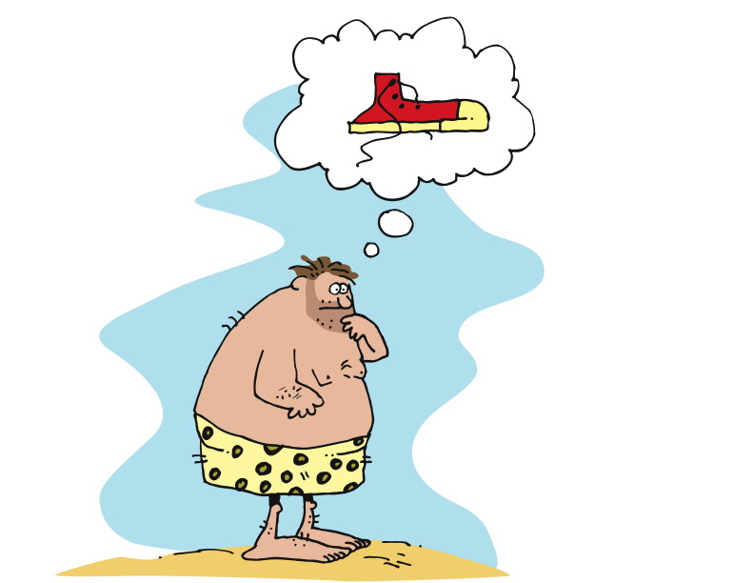
An Idea
Notes:
Test-Driven Design / Test-First
“Test-driven development (TDD) is a software development technique that uses short development iterations based on pre-written test cases that define desired improvements or new functions. Each iteration produces code necessary to pass that iteration's tests. Finally, the programmer or team refactors the code to accommodate changes. A key TDD concept is that preparing tests before coding facilitates rapid feedback changes. Note that test-driven development is a software design method, not merely a method of testing.”
http://en.wikipedia.org/wiki/Test-driven_development
First figure out how to determine if you’ve succeeded, then build it
Concept: Waterfall version
* Frames:
Barefoot, primitive man with idea of shoes
Man tells someone else what he’s thinking
Other man constructing something in his cave
Other man delivers something that is outrageous, and loosely like shoes
Original man wearing (things), looking unhappy and confused
Concept: making shoes – they must fit the foot
* Frames:
Frame: barefoot, primitive man with idea of shoes – walking over stones, through streams, kicking a (coconut),…
Frame:
Text: TEST FAILS
Image: man stepping on rocks, painful
Frame:
Text: DEVELOP
Image: man attaching cords/strips of leather to a piece of bark
Frame:
Text: TEST PASS
Image: man with piece of bark strapped to foot, satisfied look
Frame:
Text: REFACTOR
Image: man cuts bark to shape of foot
Frame:
Text: TEST FAILS
Image: man walking under falling pebbles, pebbles hitting top of foot, man looking pained

Slide 6
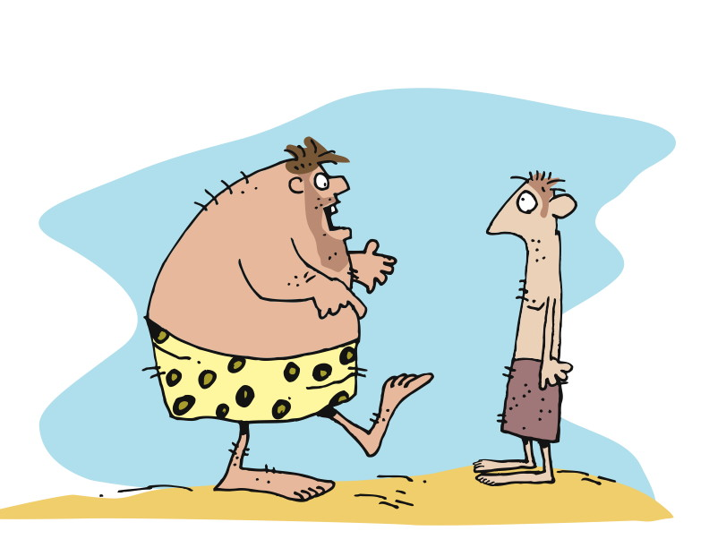
Requirements
Notes:
Test-Driven Design / Test-First
“Test-driven development (TDD) is a software development technique that uses short development iterations based on pre-written test cases that define desired improvements or new functions. Each iteration produces code necessary to pass that iteration's tests. Finally, the programmer or team refactors the code to accommodate changes. A key TDD concept is that preparing tests before coding facilitates rapid feedback changes. Note that test-driven development is a software design method, not merely a method of testing.”
http://en.wikipedia.org/wiki/Test-driven_development
First figure out how to determine if you’ve succeeded, then build it
Concept: Waterfall version
* Frames:
Barefoot, primitive man with idea of shoes
Man tells someone else what he’s thinking
Other man constructing something in his cave
Other man delivers something that is outrageous, and loosely like shoes
Original man wearing (things), looking unhappy and confused
Concept: making shoes – they must fit the foot
* Frames:
Frame: barefoot, primitive man with idea of shoes – walking over stones, through streams, kicking a (coconut),…
Frame:
Text: TEST FAILS
Image: man stepping on rocks, painful
Frame:
Text: DEVELOP
Image: man attaching cords/strips of leather to a piece of bark
Frame:
Text: TEST PASS
Image: man with piece of bark strapped to foot, satisfied look
Frame:
Text: REFACTOR
Image: man cuts bark to shape of foot
Frame:
Text: TEST FAILS
Image: man walking under falling pebbles, pebbles hitting top of foot, man looking pained

Slide 7
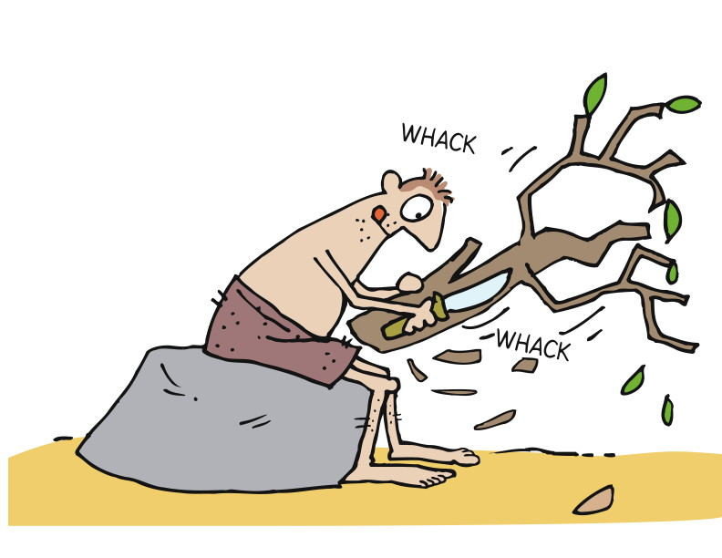
Development
Notes:
Test-Driven Design / Test-First
“Test-driven development (TDD) is a software development technique that uses short development iterations based on pre-written test cases that define desired improvements or new functions. Each iteration produces code necessary to pass that iteration's tests. Finally, the programmer or team refactors the code to accommodate changes. A key TDD concept is that preparing tests before coding facilitates rapid feedback changes. Note that test-driven development is a software design method, not merely a method of testing.”
http://en.wikipedia.org/wiki/Test-driven_development
First figure out how to determine if you’ve succeeded, then build it
Concept: Waterfall version
* Frames:
Barefoot, primitive man with idea of shoes
Man tells someone else what he’s thinking
Other man constructing something in his cave
Other man delivers something that is outrageous, and loosely like shoes
Original man wearing (things), looking unhappy and confused
Concept: making shoes – they must fit the foot
* Frames:
Frame: barefoot, primitive man with idea of shoes – walking over stones, through streams, kicking a (coconut),…
Frame:
Text: TEST FAILS
Image: man stepping on rocks, painful
Frame:
Text: DEVELOP
Image: man attaching cords/strips of leather to a piece of bark
Frame:
Text: TEST PASS
Image: man with piece of bark strapped to foot, satisfied look
Frame:
Text: REFACTOR
Image: man cuts bark to shape of foot
Frame:
Text: TEST FAILS
Image: man walking under falling pebbles, pebbles hitting top of foot, man looking pained

Slide 8
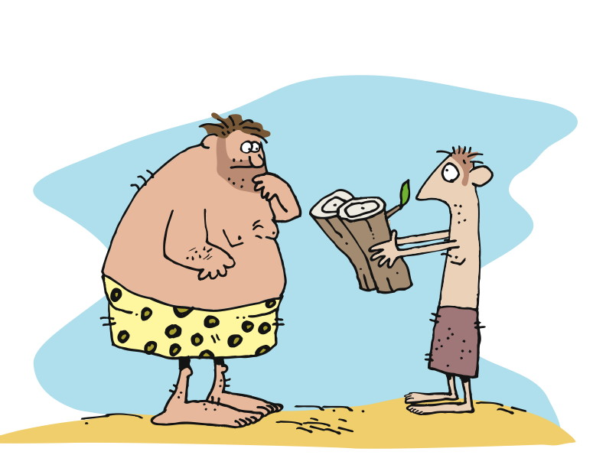
Ready for Testing
Notes:
Test-Driven Design / Test-First
“Test-driven development (TDD) is a software development technique that uses short development iterations based on pre-written test cases that define desired improvements or new functions. Each iteration produces code necessary to pass that iteration's tests. Finally, the programmer or team refactors the code to accommodate changes. A key TDD concept is that preparing tests before coding facilitates rapid feedback changes. Note that test-driven development is a software design method, not merely a method of testing.”
http://en.wikipedia.org/wiki/Test-driven_development
First figure out how to determine if you’ve succeeded, then build it
Concept: Waterfall version
* Frames:
Barefoot, primitive man with idea of shoes
Man tells someone else what he’s thinking
Other man constructing something in his cave
Other man delivers something that is outrageous, and loosely like shoes
Original man wearing (things), looking unhappy and confused
Concept: making shoes – they must fit the foot
* Frames:
Frame: barefoot, primitive man with idea of shoes – walking over stones, through streams, kicking a (coconut),…
Frame:
Text: TEST FAILS
Image: man stepping on rocks, painful
Frame:
Text: DEVELOP
Image: man attaching cords/strips of leather to a piece of bark
Frame:
Text: TEST PASS
Image: man with piece of bark strapped to foot, satisfied look
Frame:
Text: REFACTOR
Image: man cuts bark to shape of foot
Frame:
Text: TEST FAILS
Image: man walking under falling pebbles, pebbles hitting top of foot, man looking pained

Slide 9
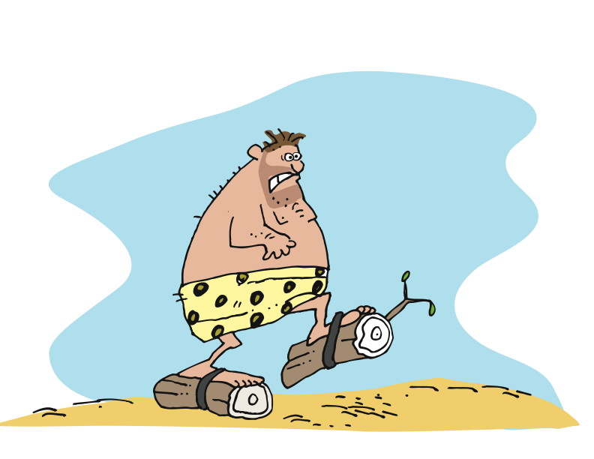
User Acceptance Testing
Notes:
Test-Driven Design / Test-First
“Test-driven development (TDD) is a software development technique that uses short development iterations based on pre-written test cases that define desired improvements or new functions. Each iteration produces code necessary to pass that iteration's tests. Finally, the programmer or team refactors the code to accommodate changes. A key TDD concept is that preparing tests before coding facilitates rapid feedback changes. Note that test-driven development is a software design method, not merely a method of testing.”
http://en.wikipedia.org/wiki/Test-driven_development
First figure out how to determine if you’ve succeeded, then build it
Concept: Waterfall version
* Frames:
Barefoot, primitive man with idea of shoes
Man tells someone else what he’s thinking
Other man constructing something in his cave
Other man delivers something that is outrageous, and loosely like shoes
Original man wearing (things), looking unhappy and confused
Concept: making shoes – they must fit the foot
* Frames:
Frame: barefoot, primitive man with idea of shoes – walking over stones, through streams, kicking a (coconut),…
Frame:
Text: TEST FAILS
Image: man stepping on rocks, painful
Frame:
Text: DEVELOP
Image: man attaching cords/strips of leather to a piece of bark
Frame:
Text: TEST PASS
Image: man with piece of bark strapped to foot, satisfied look
Frame:
Text: REFACTOR
Image: man cuts bark to shape of foot
Frame:
Text: TEST FAILS
Image: man walking under falling pebbles, pebbles hitting top of foot, man looking pained

Slide 10
Test-Driven Development

Slide 11
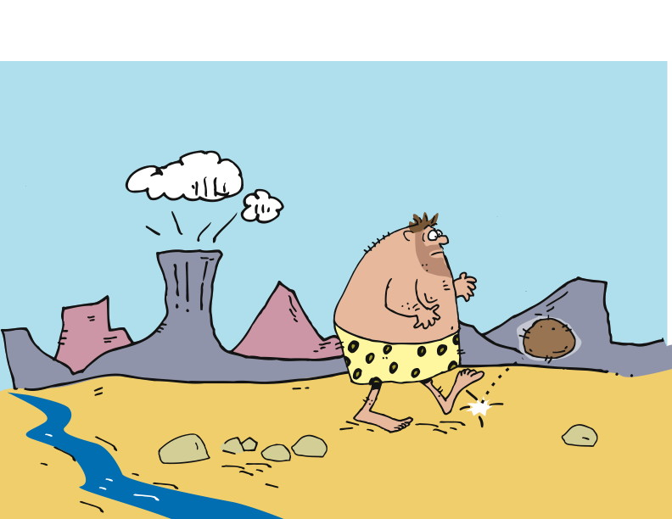
A User Story
Notes:
Test-Driven Design / Test-First
“Test-driven development (TDD) is a software development technique that uses short development iterations based on pre-written test cases that define desired improvements or new functions. Each iteration produces code necessary to pass that iteration's tests. Finally, the programmer or team refactors the code to accommodate changes. A key TDD concept is that preparing tests before coding facilitates rapid feedback changes. Note that test-driven development is a software design method, not merely a method of testing.”
http://en.wikipedia.org/wiki/Test-driven_development
First figure out how to determine if you’ve succeeded, then build it
Concept: Waterfall version
* Frames:
Barefoot, primitive man with idea of shoes
Man tells someone else what he’s thinking
Other man constructing something in his cave
Other man delivers something that is outrageous, and loosely like shoes
Original man wearing (things), looking unhappy and confused
Concept: making shoes – they must fit the foot
* Frames:
Frame: barefoot, primitive man with idea of shoes – walking over stones, through streams, kicking a (coconut),…
Frame:
Text: TEST FAILS
Image: man stepping on rocks, painful
Frame:
Text: DEVELOP
Image: man attaching cords/strips of leather to a piece of bark
Frame:
Text: TEST PASS
Image: man with piece of bark strapped to foot, satisfied look
Frame:
Text: REFACTOR
Image: man cuts bark to shape of foot
Frame:
Text: TEST FAILS
Image: man walking under falling pebbles, pebbles hitting top of foot, man looking pained

Slide 12
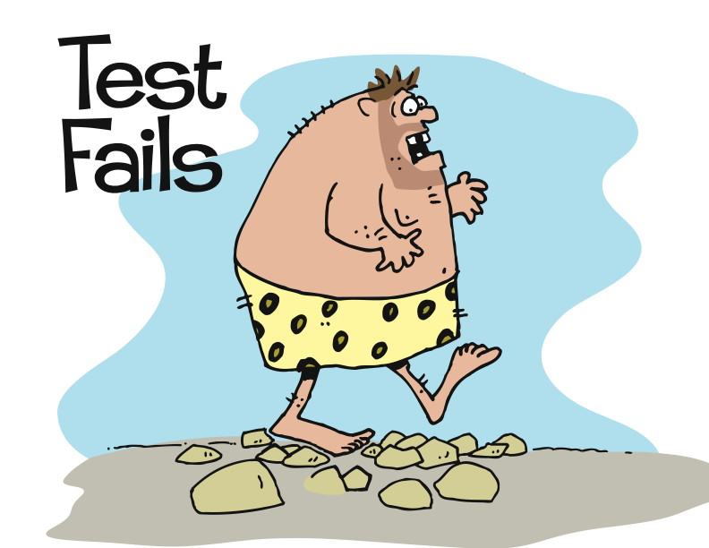
Test First
Notes:
Test-Driven Design / Test-First
“Test-driven development (TDD) is a software development technique that uses short development iterations based on pre-written test cases that define desired improvements or new functions. Each iteration produces code necessary to pass that iteration's tests. Finally, the programmer or team refactors the code to accommodate changes. A key TDD concept is that preparing tests before coding facilitates rapid feedback changes. Note that test-driven development is a software design method, not merely a method of testing.”
http://en.wikipedia.org/wiki/Test-driven_development
First figure out how to determine if you’ve succeeded, then build it
Concept: Waterfall version
* Frames:
Barefoot, primitive man with idea of shoes
Man tells someone else what he’s thinking
Other man constructing something in his cave
Other man delivers something that is outrageous, and loosely like shoes
Original man wearing (things), looking unhappy and confused
Concept: making shoes – they must fit the foot
* Frames:
Frame: barefoot, primitive man with idea of shoes – walking over stones, through streams, kicking a (coconut),…
Frame:
Text: TEST FAILS
Image: man stepping on rocks, painful
Frame:
Text: DEVELOP
Image: man attaching cords/strips of leather to a piece of bark
Frame:
Text: TEST PASS
Image: man with piece of bark strapped to foot, satisfied look
Frame:
Text: REFACTOR
Image: man cuts bark to shape of foot
Frame:
Text: TEST FAILS
Image: man walking under falling pebbles, pebbles hitting top of foot, man looking pained

Slide 13
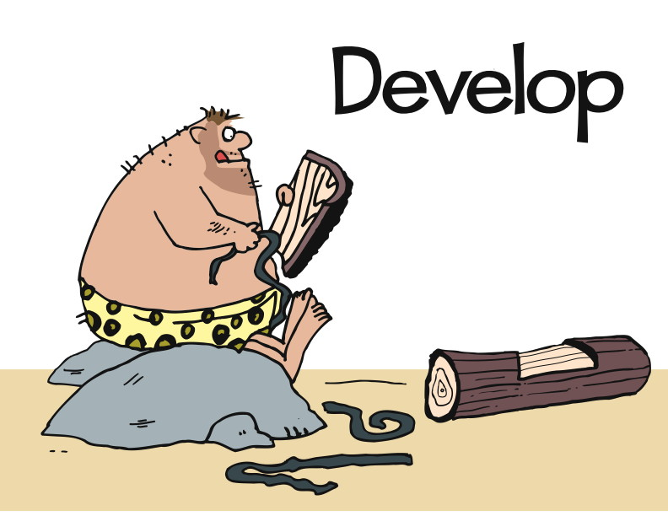
Notes:
Test-Driven Design / Test-First
“Test-driven development (TDD) is a software development technique that uses short development iterations based on pre-written test cases that define desired improvements or new functions. Each iteration produces code necessary to pass that iteration's tests. Finally, the programmer or team refactors the code to accommodate changes. A key TDD concept is that preparing tests before coding facilitates rapid feedback changes. Note that test-driven development is a software design method, not merely a method of testing.”
http://en.wikipedia.org/wiki/Test-driven_development
First figure out how to determine if you’ve succeeded, then build it
Concept: Waterfall version
* Frames:
Barefoot, primitive man with idea of shoes
Man tells someone else what he’s thinking
Other man constructing something in his cave
Other man delivers something that is outrageous, and loosely like shoes
Original man wearing (things), looking unhappy and confused
Concept: making shoes – they must fit the foot
* Frames:
Frame: barefoot, primitive man with idea of shoes – walking over stones, through streams, kicking a (coconut),…
Frame:
Text: TEST FAILS
Image: man stepping on rocks, painful
Frame:
Text: DEVELOP
Image: man attaching cords/strips of leather to a piece of bark
Frame:
Text: TEST PASS
Image: man with piece of bark strapped to foot, satisfied look
Frame:
Text: REFACTOR
Image: man cuts bark to shape of foot
Frame:
Text: TEST FAILS
Image: man walking under falling pebbles, pebbles hitting top of foot, man looking pained

Slide 14
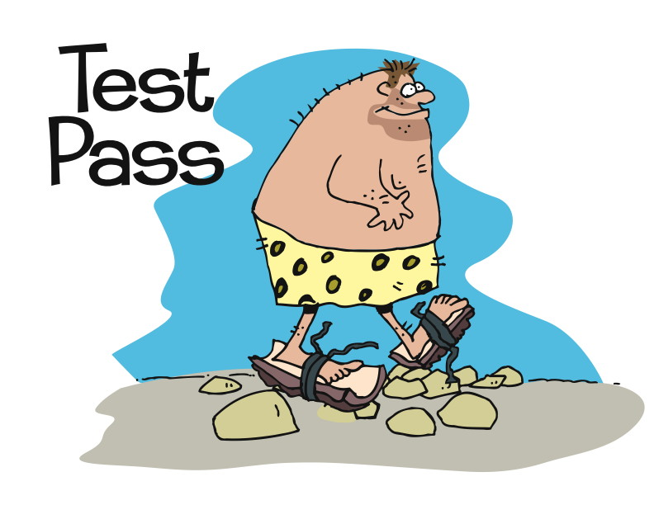
Notes:
Test-Driven Design / Test-First
“Test-driven development (TDD) is a software development technique that uses short development iterations based on pre-written test cases that define desired improvements or new functions. Each iteration produces code necessary to pass that iteration's tests. Finally, the programmer or team refactors the code to accommodate changes. A key TDD concept is that preparing tests before coding facilitates rapid feedback changes. Note that test-driven development is a software design method, not merely a method of testing.”
http://en.wikipedia.org/wiki/Test-driven_development
First figure out how to determine if you’ve succeeded, then build it
Concept: Waterfall version
* Frames:
Barefoot, primitive man with idea of shoes
Man tells someone else what he’s thinking
Other man constructing something in his cave
Other man delivers something that is outrageous, and loosely like shoes
Original man wearing (things), looking unhappy and confused
Concept: making shoes – they must fit the foot
* Frames:
Frame: barefoot, primitive man with idea of shoes – walking over stones, through streams, kicking a (coconut),…
Frame:
Text: TEST FAILS
Image: man stepping on rocks, painful
Frame:
Text: DEVELOP
Image: man attaching cords/strips of leather to a piece of bark
Frame:
Text: TEST PASS
Image: man with piece of bark strapped to foot, satisfied look
Frame:
Text: REFACTOR
Image: man cuts bark to shape of foot
Frame:
Text: TEST FAILS
Image: man walking under falling pebbles, pebbles hitting top of foot, man looking pained

Slide 15
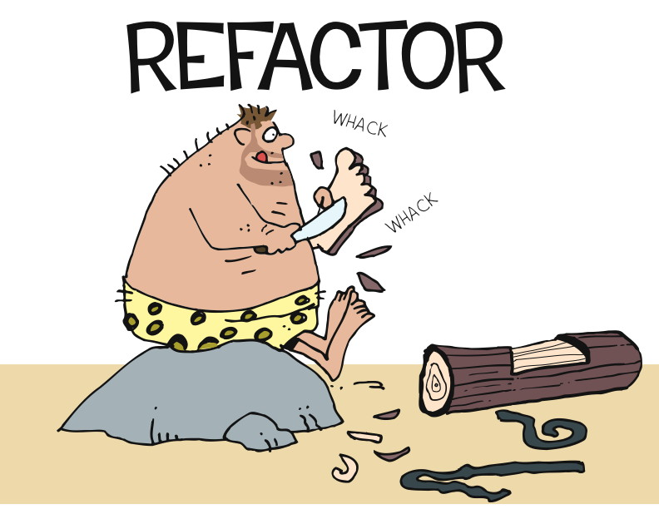
Notes:
Test-Driven Design / Test-First
“Test-driven development (TDD) is a software development technique that uses short development iterations based on pre-written test cases that define desired improvements or new functions. Each iteration produces code necessary to pass that iteration's tests. Finally, the programmer or team refactors the code to accommodate changes. A key TDD concept is that preparing tests before coding facilitates rapid feedback changes. Note that test-driven development is a software design method, not merely a method of testing.”
http://en.wikipedia.org/wiki/Test-driven_development
First figure out how to determine if you’ve succeeded, then build it
Concept: Waterfall version
* Frames:
Barefoot, primitive man with idea of shoes
Man tells someone else what he’s thinking
Other man constructing something in his cave
Other man delivers something that is outrageous, and loosely like shoes
Original man wearing (things), looking unhappy and confused
Concept: making shoes – they must fit the foot
* Frames:
Frame: barefoot, primitive man with idea of shoes – walking over stones, through streams, kicking a (coconut),…
Frame:
Text: TEST FAILS
Image: man stepping on rocks, painful
Frame:
Text: DEVELOP
Image: man attaching cords/strips of leather to a piece of bark
Frame:
Text: TEST PASS
Image: man with piece of bark strapped to foot, satisfied look
Frame:
Text: REFACTOR
Image: man cuts bark to shape of foot
Frame:
Text: TEST FAILS
Image: man walking under falling pebbles, pebbles hitting top of foot, man looking pained

Slide 16
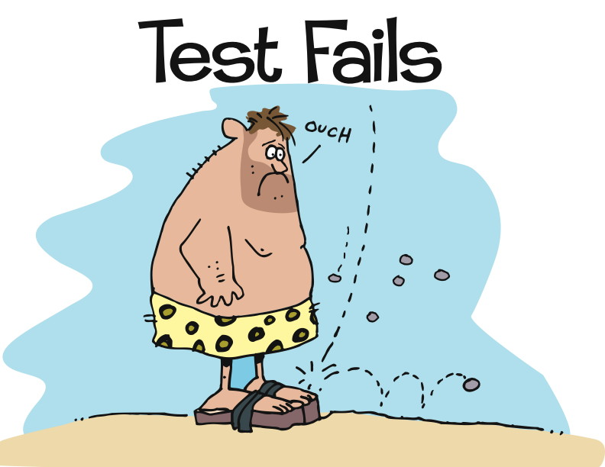
Add Tests
Notes:
Test-Driven Design / Test-First
“Test-driven development (TDD) is a software development technique that uses short development iterations based on pre-written test cases that define desired improvements or new functions. Each iteration produces code necessary to pass that iteration's tests. Finally, the programmer or team refactors the code to accommodate changes. A key TDD concept is that preparing tests before coding facilitates rapid feedback changes. Note that test-driven development is a software design method, not merely a method of testing.”
http://en.wikipedia.org/wiki/Test-driven_development
First figure out how to determine if you’ve succeeded, then build it
Concept: Waterfall version
* Frames:
Barefoot, primitive man with idea of shoes
Man tells someone else what he’s thinking
Other man constructing something in his cave
Other man delivers something that is outrageous, and loosely like shoes
Original man wearing (things), looking unhappy and confused
Concept: making shoes – they must fit the foot
* Frames:
Frame: barefoot, primitive man with idea of shoes – walking over stones, through streams, kicking a (coconut),…
Frame:
Text: TEST FAILS
Image: man stepping on rocks, painful
Frame:
Text: DEVELOP
Image: man attaching cords/strips of leather to a piece of bark
Frame:
Text: TEST PASS
Image: man with piece of bark strapped to foot, satisfied look
Frame:
Text: REFACTOR
Image: man cuts bark to shape of foot
Frame:
Text: TEST FAILS
Image: man walking under falling pebbles, pebbles hitting top of foot, man looking pained

Slide 17
Test Driven Development
Why TDD?
All your code is testable by definition
Encourages better design by enforcing loose coupling
Tests as documentation
Clear examples of how to use APIs
Provably correct documentation
Confidence to allow refactoring
Can change the underlying design without changing behavior

Slide 18
TDD Demo

Slide 19
Red – Green - Refactor
Red
The development of every new feature should start with a failing test
Green
Enough production code should be written to make the test pass.
Refactor
Improve the structure of the code to ease future changes and maintenance.

Slide 20
Test Driven Development
Uncle Bob Martin’s Three Laws of TDD
You are not allowed to write any production code unless it is to make a failing unit test pass
You are not allowed to write any more of a unit test than is sufficient to fail; and compilation failures are failures
You are not allowed to write any more production code than is sufficient to pass the one failing unit test

Slide 21
Fundamental of writing unit test
Setup
Execute
Verify

Slide 22
Organizing Tests
One test class per class
Test case per scenario

Slide 23
Some Key Points.
Test names should be ‘intentional’
Keep Test Logic Out of Production Code
There should be no code like if(testing) … else …
Ideally one assert per test.

Slide 24
Michael Feathers Rule of thumb
A test is not a unit test if:
It talks to the database
It communicates across the network
It touches the file system
It can't run at the same time as any of your other unit tests
You have to do special things to your environment (such as editing config files) to run it.

